Slide 1
Digital Portfolio
STUDENT NAME: SIVAPRAKASH.V
REGISTER NO AND NMID: 2413225180251052
DEPARTMENT: B.SC COMPUTER SCIENCE
COLLEGE: COLLEGE/ GOVERNMENT ARST SCIENCE COLLEGE ANNAMALAI UNIVERSITY

Slide 2
PROJECT TITLE
Student digital portfolio structure 1. Project title A short meaningful and catchy title that reflects your project

Slide 3


AGENDA
Problem Statement
Project Overview
End Users
Tools and Technologies
Portfolio design and Layout
Features and Functionality
Results and Screenshots
Conclusion
Github Link
3/21/2024 Annual Review

Slide 4

PROBLEM STATEMENT
Problem statement Clearly define the problem your project aims to solve Explain why this problem exists and why it matters

Slide 5

PROJECT OVERVIEW
Project overview A summary of your project idea Mention the objectives scope and approach
System memory soil mystic level and automatic
Rajat mention the objectives core approach

Slide 6

WHO ARE THE END USERS?
(Mention who will use the project or benefit from it)
Students
TeachersSchool/
College Administration

Slide 7

TOOLS AND TECHNIQUES
List of software, hardware, programming Languages, and methods use
hardware, programming Languages, and methods used.

Slide 8
POTFOLIO DESIGN AND LAYOUT
(Describe the design of your digital portfolio.) Homepage: Introduction, project title, and student details Project Section: Problem statement, overview. Tools. Screenshots Features Page: Key explained Results Page: Outcomes and screenshots Conclusion Page: Summary and learnings Clean and minimal layout with images, icons, and diagrams
8

Slide 9
FEATURES AND FUNCTIONALITY
Automatic face detection and recognition
Real-time attendance marking
Secure database storage
Report generation (daily/weekly/monthly)User-friendly dashboard

Slide 10
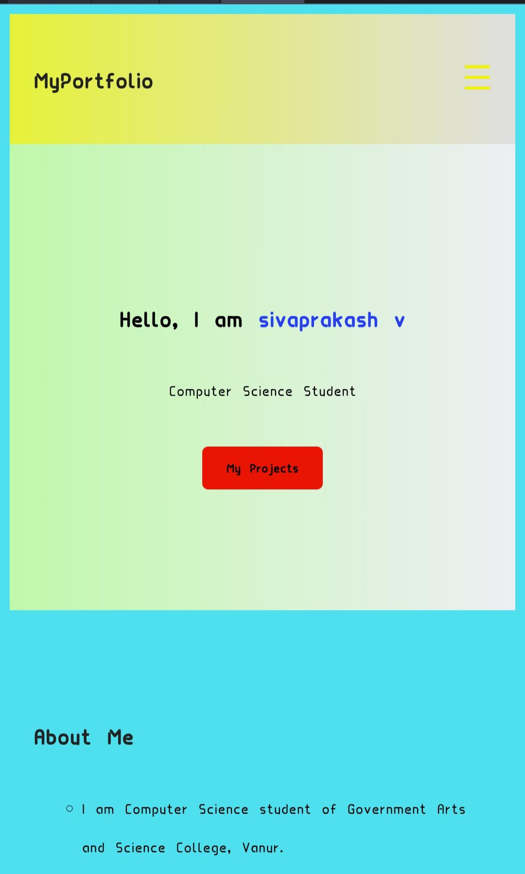
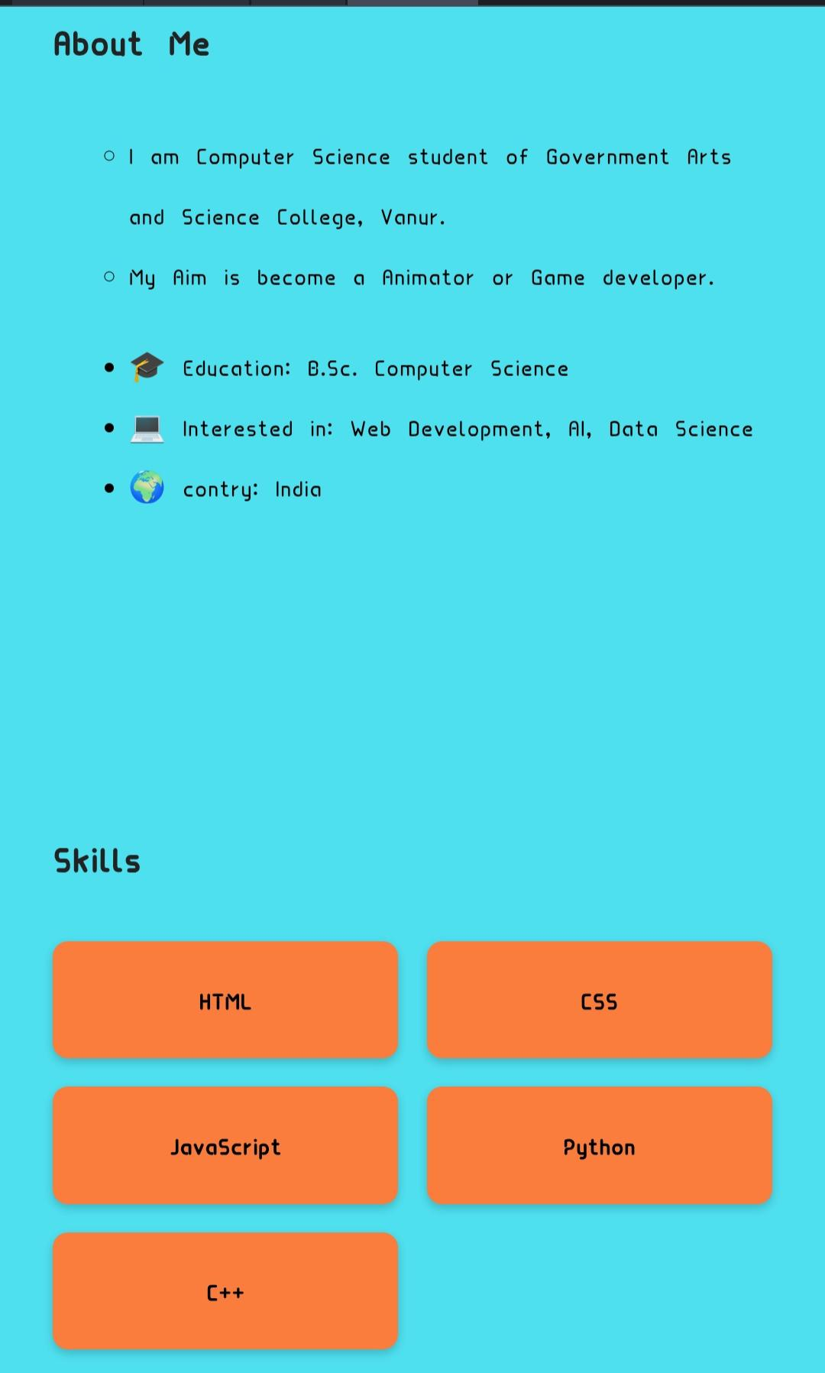

RESULTS AND SCREENSHOTS
3/21/2024 Annual Review
10

Slide 11
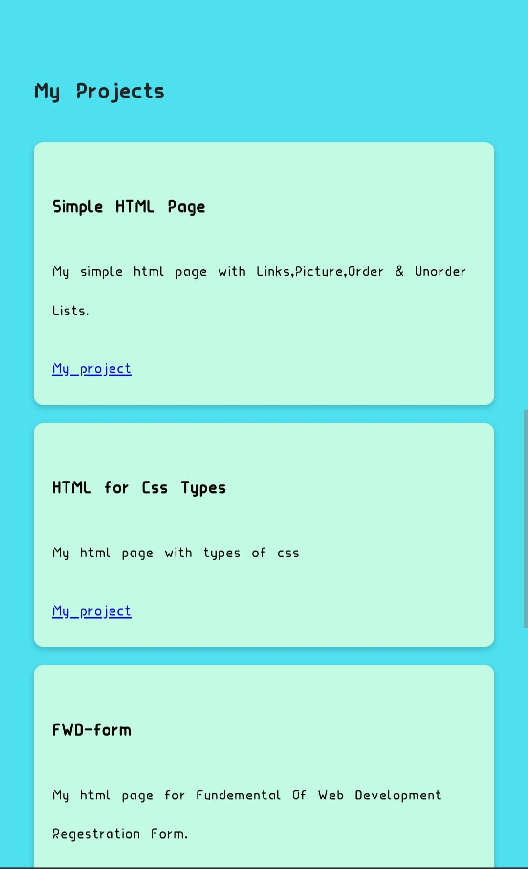
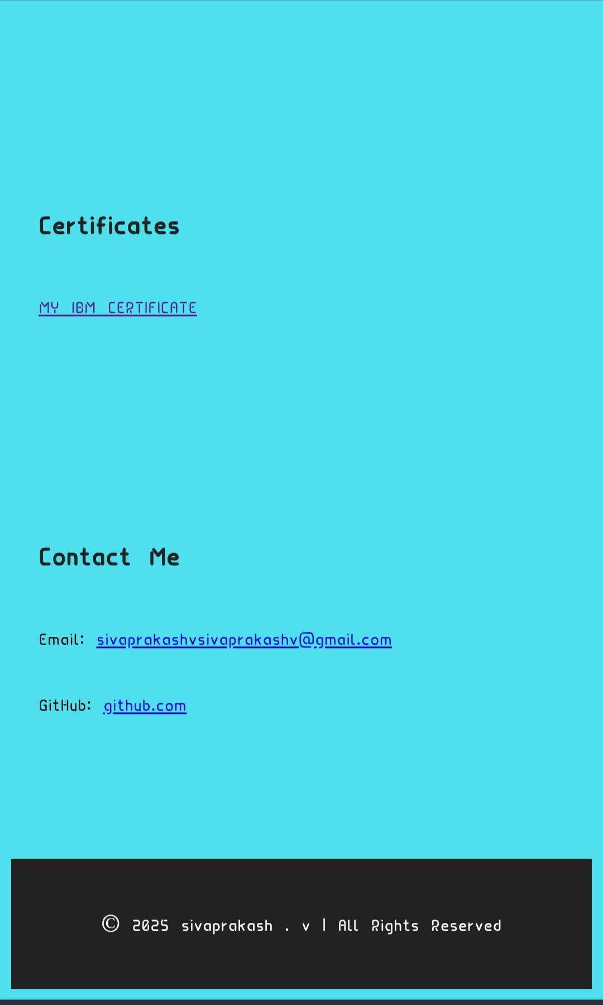
Results and Screenshot

Slide 12
CONCLUSION
The Smart Attendance System successfully reduced manual effort and prevented proxy attendance. It enhanced accuracy and efficiency in the classroom environment.
Challenges Faced: Lighting conditions and similar facial features.
Future Scope: Integration with mobile apps, cloud storage, and Al-based predictive analysis.
12

Slide 13
Github link
https://github.com/sivaprakashvsivaprakashv-create

